Slide 1
Review: Environment Setup
<Adv C & App/>
Advanced C Programming
And It’s Application
Assistant Prof. Chan, Chun-Hsiang
Department of Artificial Intelligence, Tamkang University
Sep. 29, 2021
</ Adv C & App >

Slide 2
大綱
<Outline/>
[1] Environment setup
[2] Hello world
[3] What’s compile?
C
</Outline>

Slide 3
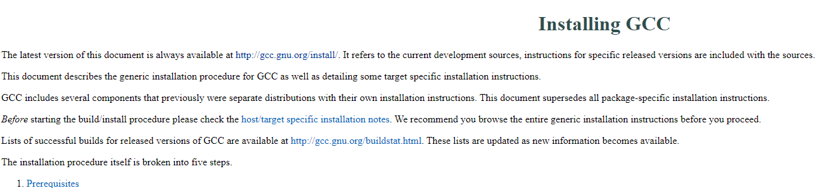
環境建置 step 1
<Environment setup/>
下載安裝編譯器
https://gcc.gnu.org/install/
安裝完記得設定環境變數。
https://sites.google.com/site/mycprogrammingbook/bu-chong-cai-liao/gccanzhuang
https://www.itread01.com/content/1541796255.html
http://kaiching.org/pydoing/c/gcc.html
</Environment setup>

Slide 4
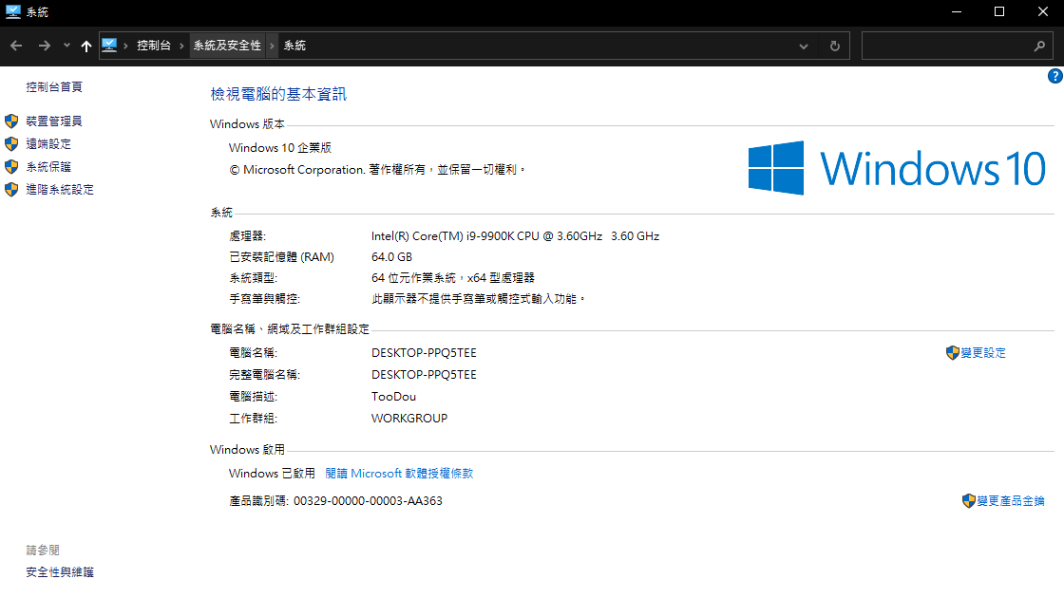
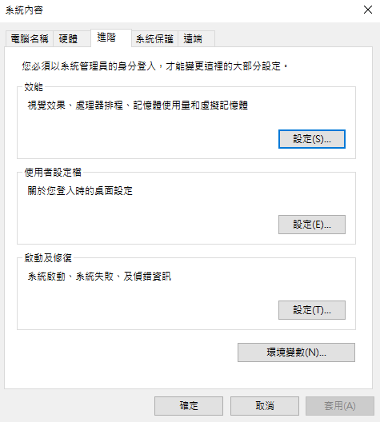
環境建置 step 1
<Environment setup/>
Step 1
Step 2
</Environment setup>

Slide 5
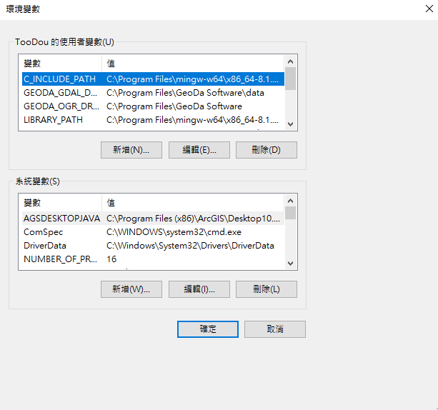
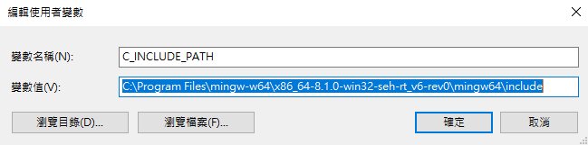
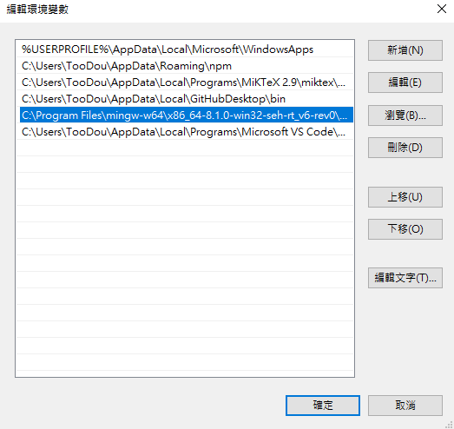
環境建置 step 1
<Environment setup/>
C:\Program Files\mingw-w64\x86_64-8.1.0-win32-seh-rt_v6-rev0\mingw64\include
Step 4
Step 5
Path
Step 3
C:\Program Files\mingw-w64\x86_64-8.1.0-win32-seh-rt_v6-rev0\mingw64\bin
Step 6
</Environment setup>

Slide 6
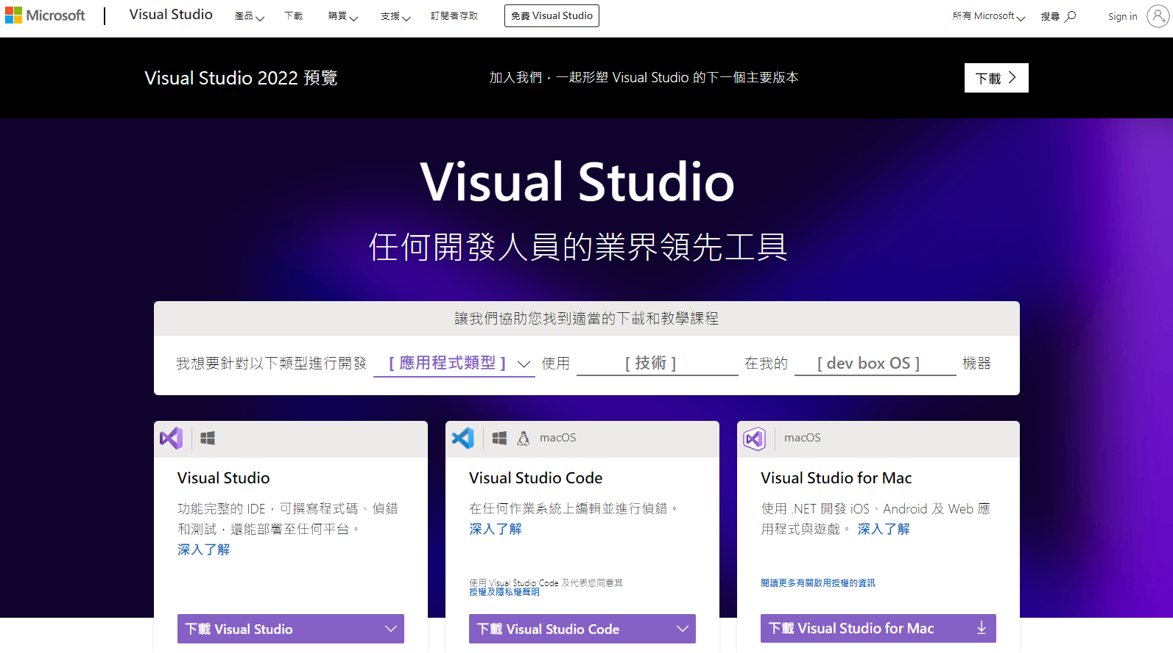
環境建置 step 2.1
<Environment setup/>
較肥的版本。。。 https://visualstudio.microsoft.com/zh-hant/
</Environment setup>

Slide 7
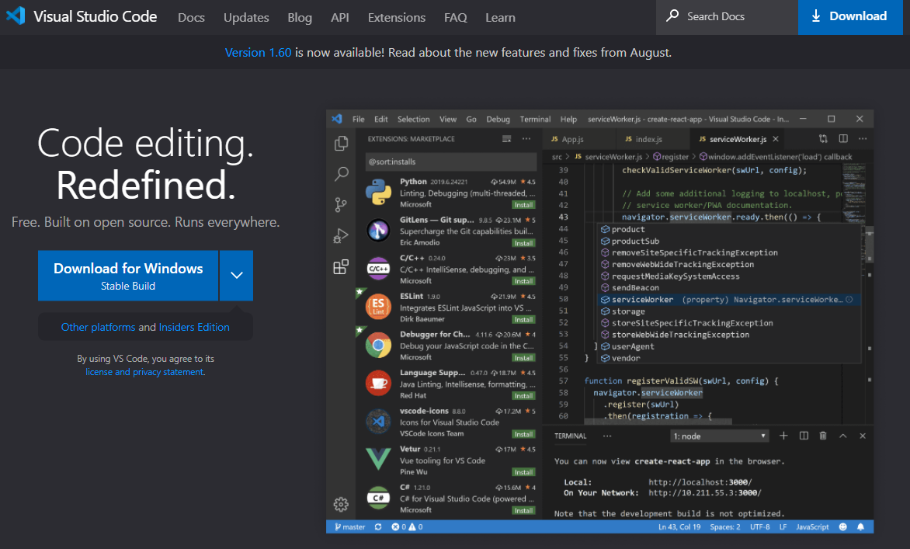
環境建置 step 2.2
<Environment setup/>
較light的版本。。。 https://code.visualstudio.com/
</Environment setup>

Slide 8
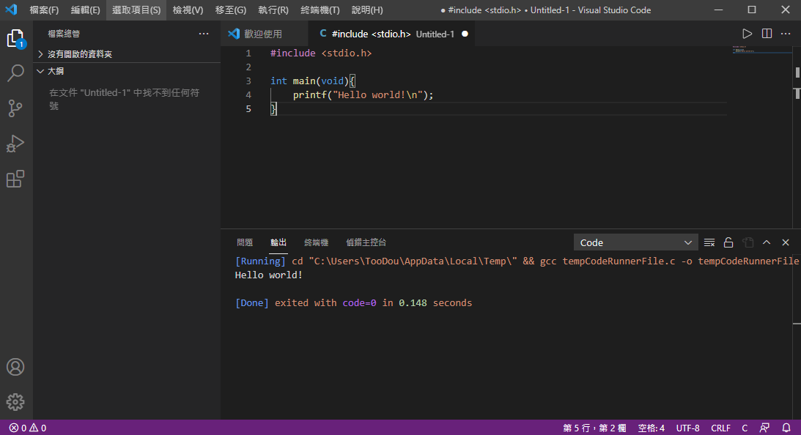
環境建置 step 2.2
<Environment setup/>
</Environment setup>

Slide 9
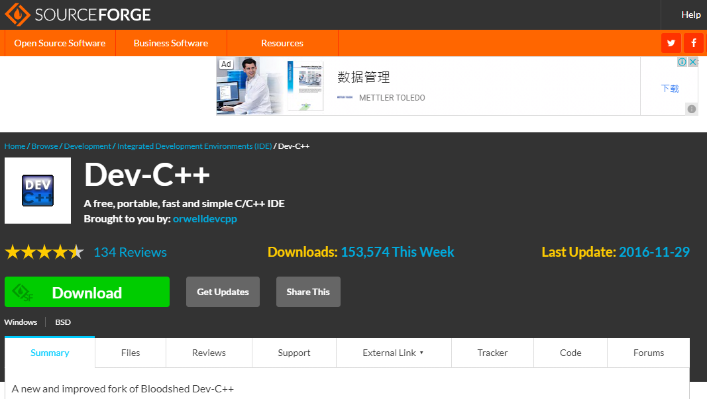
環境建置 step 2.3
<Environment setup/>
最light的版本。。。 https://sourceforge.net/projects/orwelldevcpp/
介紹網站:
https://www.csie.ntu.edu.tw/~b98902112/cpp_and_algo/devcpp/README.html
</Environment setup>

Slide 10
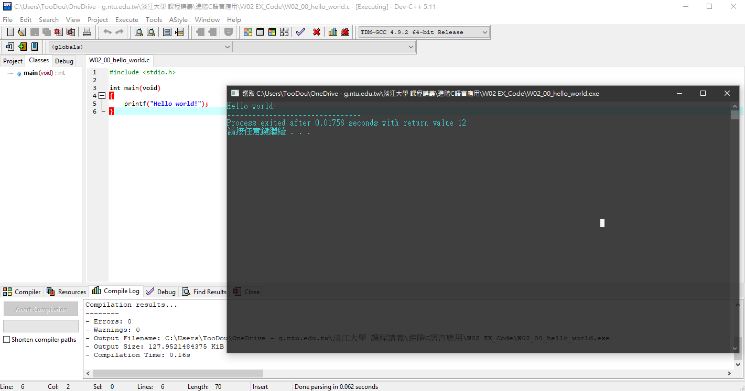
環境建置 step 2.3
<Environment setup/>
</Environment setup>

Slide 11
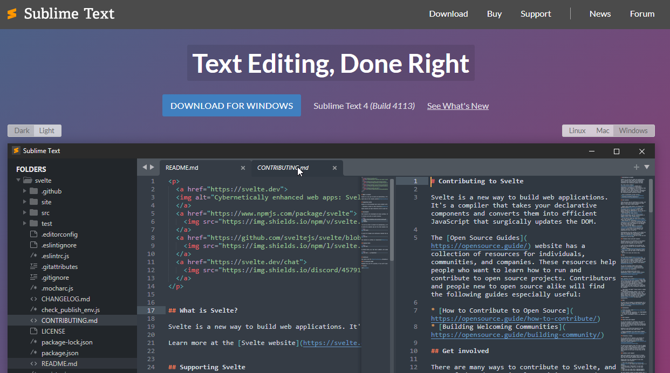
環境建置 step 2.4
<Environment setup/>
看起來比較厲害的方式。。。 https://www.sublimetext.com/
</Environment setup>

Slide 12
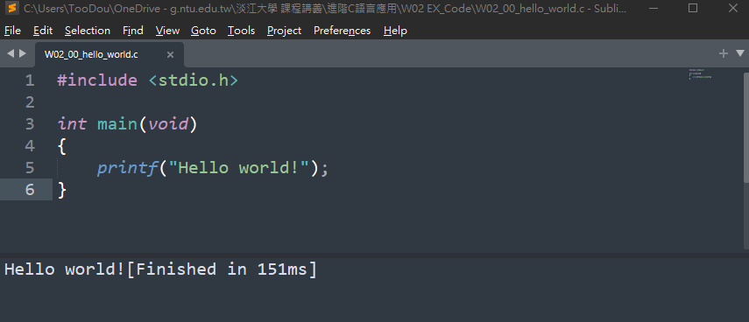
環境建置 step 2.4
<Environment setup/>
</Environment setup>

Slide 13
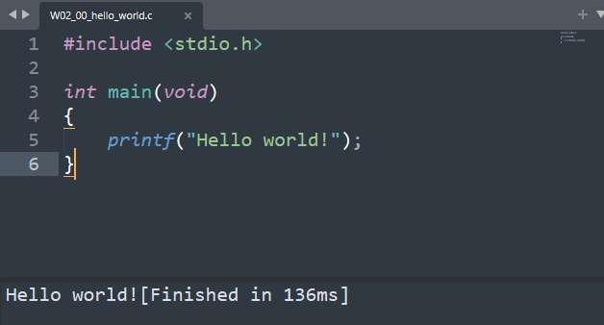
Hello world
<Hello world/>
#include <stdio.h>
int main(void)
{
printf("Hello world!");
}
* void代表不回傳任何數值
</Hello world>

Slide 14
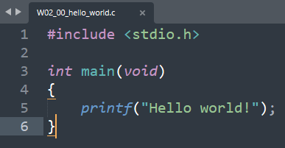
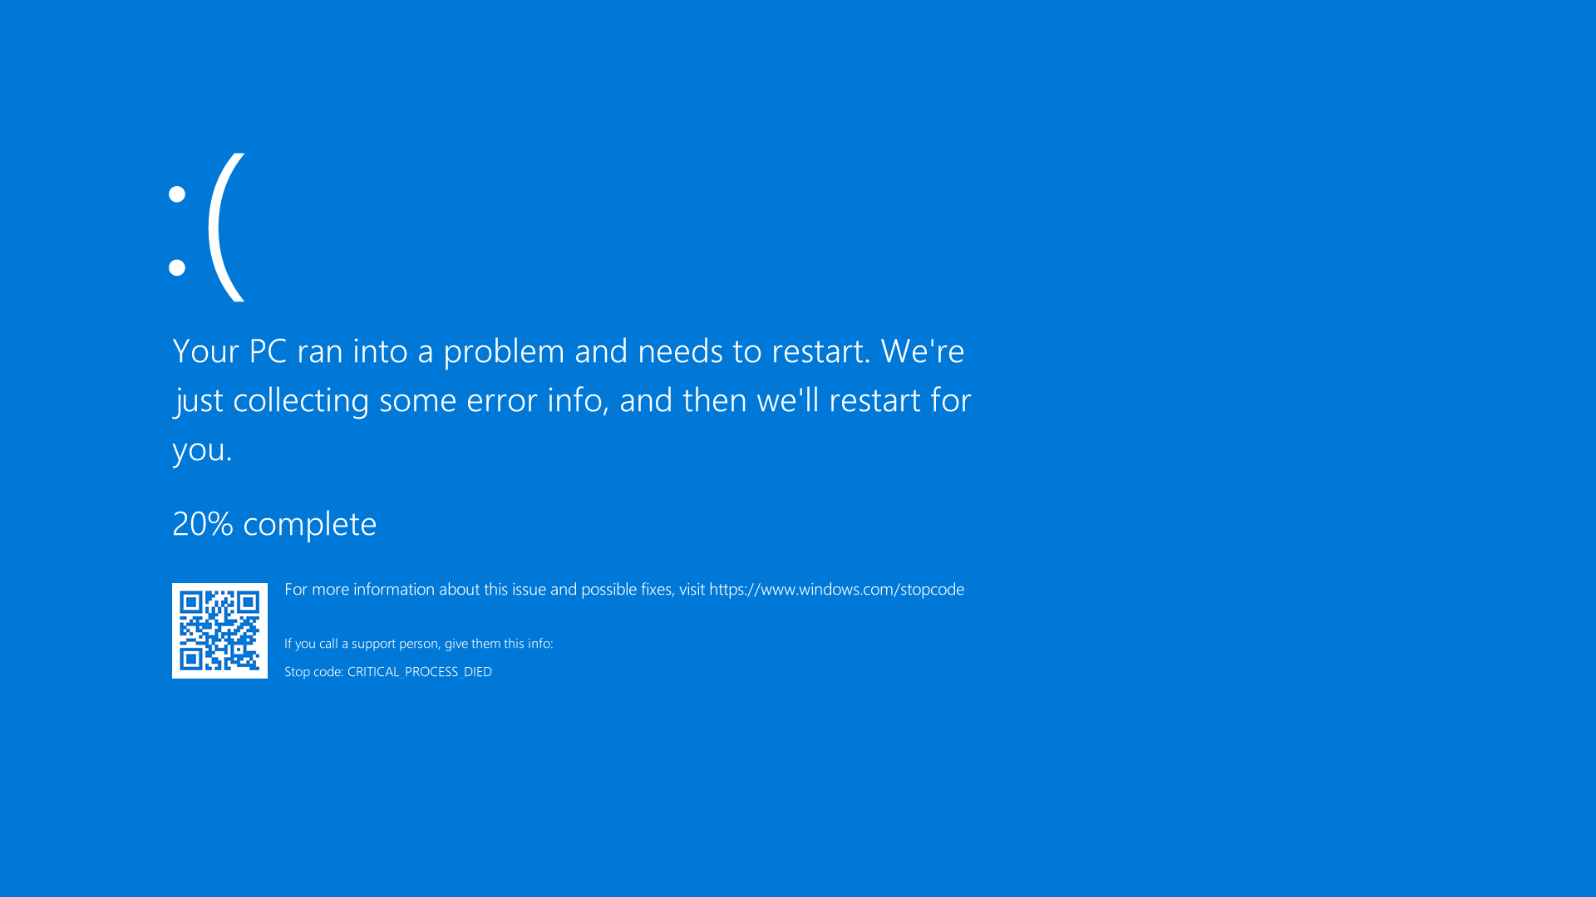

What’s compile?
<Compile/>
This is your code!
This is your computer!
Hey! Execute it!
So, what’s going on here?
Picture link: https://bit.ly/3AJQIy9
</Compile>

Slide 15
What’s compile?
<Compile/>
This is your computer!
This is your code!
0101101101010010100010101100101100110001000010000010010100010100010010
Compiler
Translation from programming language to digital language.
Picture link: https://bit.ly/3AJQIy9
</Compile>

Slide 16
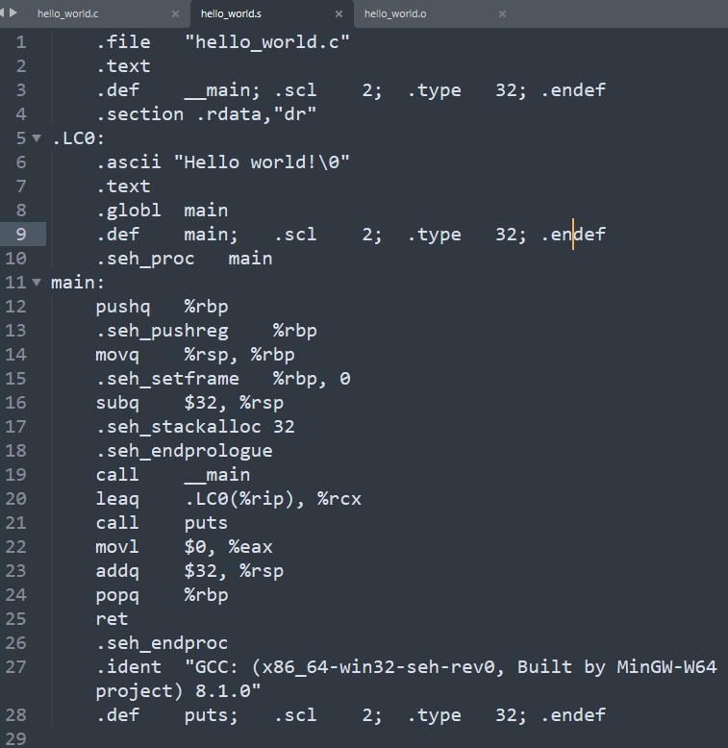
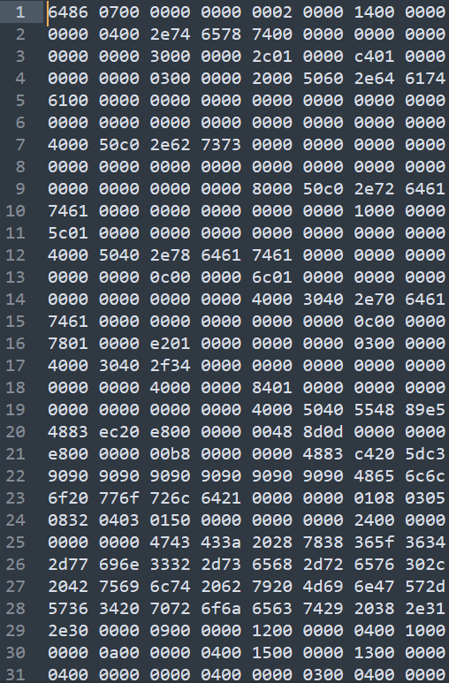
What’s compile?
<Compile/>
Compiler → Assembler → Linker
test.exe
gcc -S test.c → test.s
gcc -c test.c → test.o
execute
This is your code!
This is your computer!
Hello world!
Simple version: https://www.youtube.com/watch?v=N2y6csonII4&ab_channel=EngMicroLectures
Detailed version: https://www.youtube.com/watch?v=3tIqpEmWMLI&ab_channel=TheCherno
Picture link: https://bit.ly/3AJQIy9
</Compile>

